Slide 1
Secure Data Hiding in Image Using Steganography
CAPSTONE PROJECT
Presented By: Tanish Chouhan
College Name & Department : B.Sc. Cybersecurity (CS Dept.), IU International University of Applied Sciences

Slide 2
OUTLINE
Problem Statement
Technology used
Wow factor
End users
Results
Conclusion
Git-hub Link
Future scope

Slide 3
Problem Statement
Secure communication is essential in today's digital world. This project provides a method to hide messages inside images using steganography, ensuring confidentiality.

Slide 4
Technology used
System Requirements for Image Steganography Project
1. Hardware Requirements
Processor: Intel Core i3 or higher (or equivalent AMD)
RAM: 4GB minimum (8GB recommended for faster processing)
Storage: At least 100MB of free disk space
GPU (Optional): Required only if using advanced image processing
2. Software Requirements
Operating System: Windows 10/11, macOS, or Linux
Python Version: Python 3.x (recommended 3.8 or above)
Required Libraries:
OpenCV (cv2)
NumPy
PIL (Pillow)
argparse (for command-line arguments)
3. Additional Requirements
Python IDE (Optional): PyCharm, VS Code, or Jupyter Notebook
Permissions: Read/write access to image files

Slide 5
Wow factors
Wow Factors of the Image Steganography Project
Secret Message Encoding in Images
Hides messages inside images without visible changes.
Password-Protected Decryption
Ensures only authorized users can retrieve hidden messages.
Lightweight & Efficient
Uses OpenCV and Python, making it fast and easy to use.
No External Storage Needed
Message is embedded directly inside the image pixels.
Potential for High Security
Can be enhanced with additional encryption layers.
Stealth Communication
Messages remain invisible to unauthorized users.

Slide 6
End users
End Users of the Image Steganography Project
Cybersecurity Professionals
Use steganography for secure data transmission and cryptographic research.
Journalists & Whistleblowers
Hide confidential messages in images to avoid surveillance.
Government & Military Agencies
Secure classified communications using steganographic techniques.
Privacy-Conscious Individuals
Protect personal data and sensitive messages from unauthorized access.
Researchers & Developers
Experiment with steganography for academic and technical advancements.
Hackers & Ethical Hackers
Test security vulnerabilities and forensic analysis methods.

Slide 7
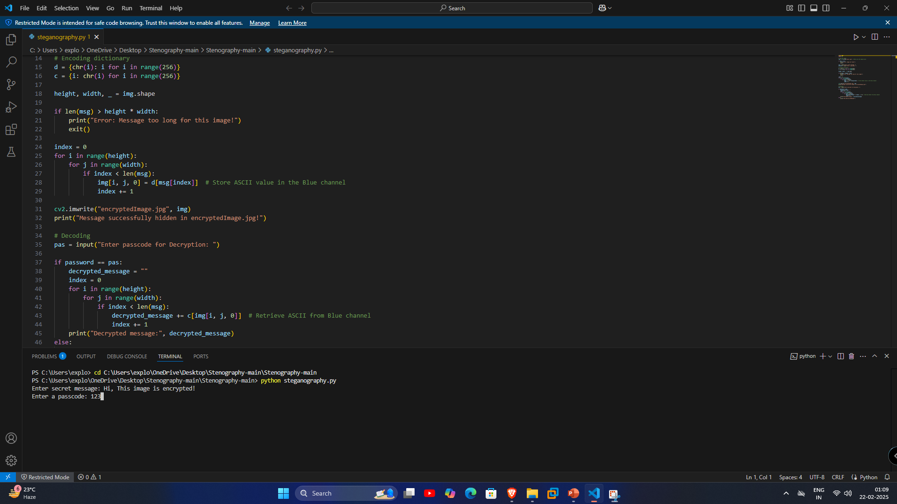
Results

Slide 8
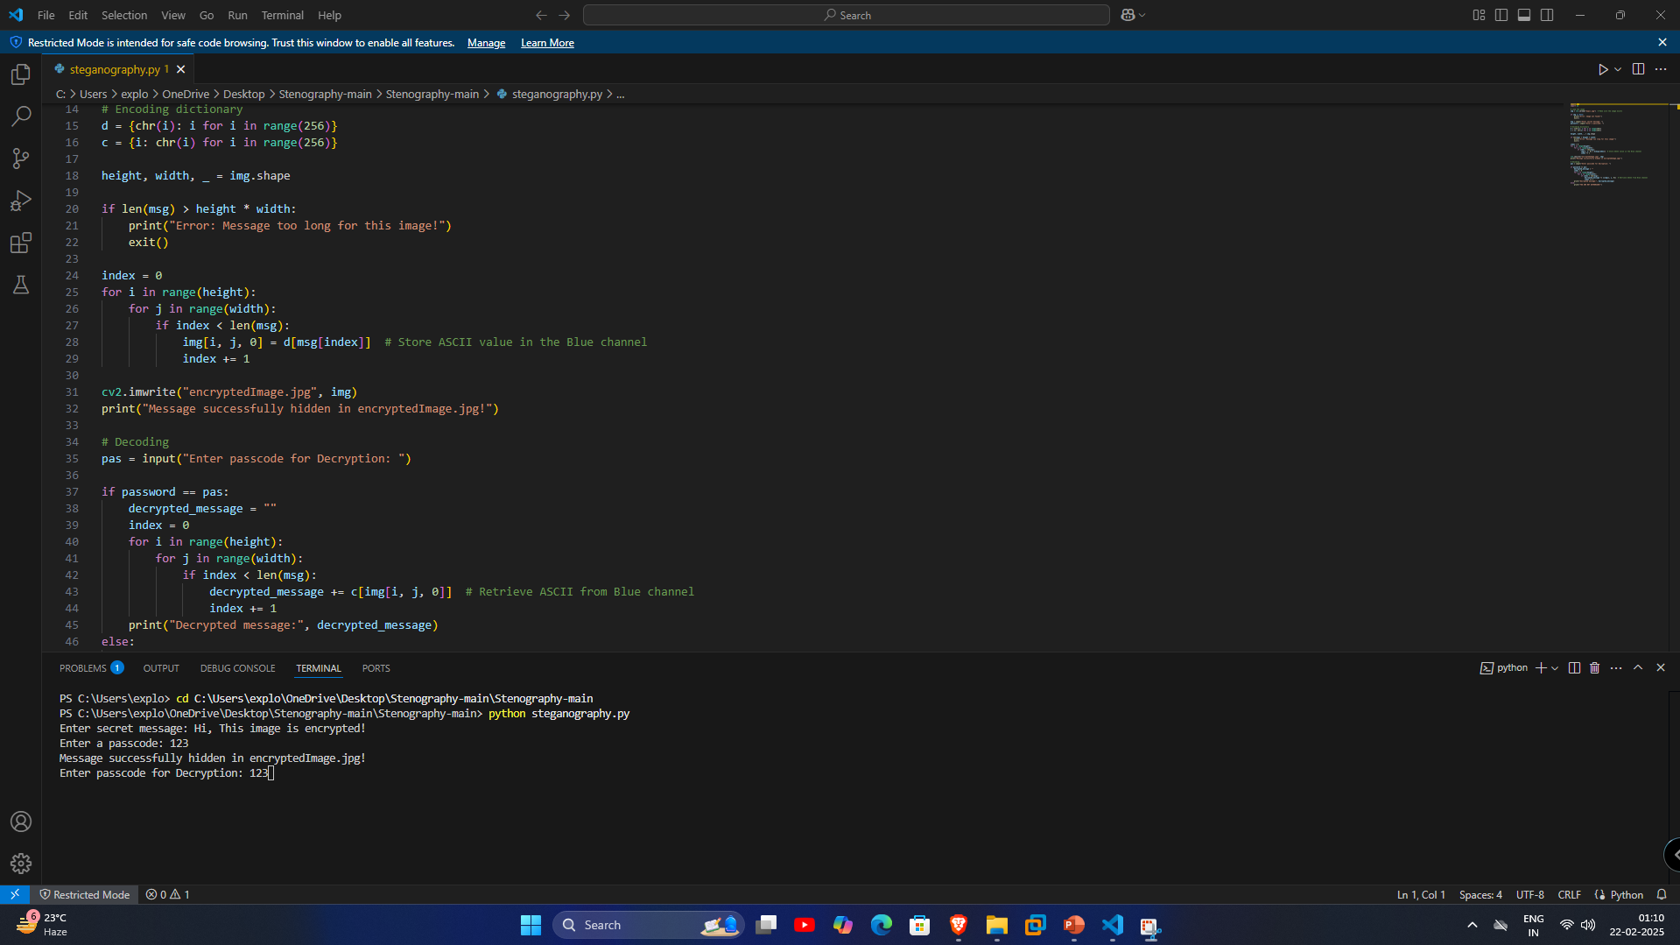

Slide 9
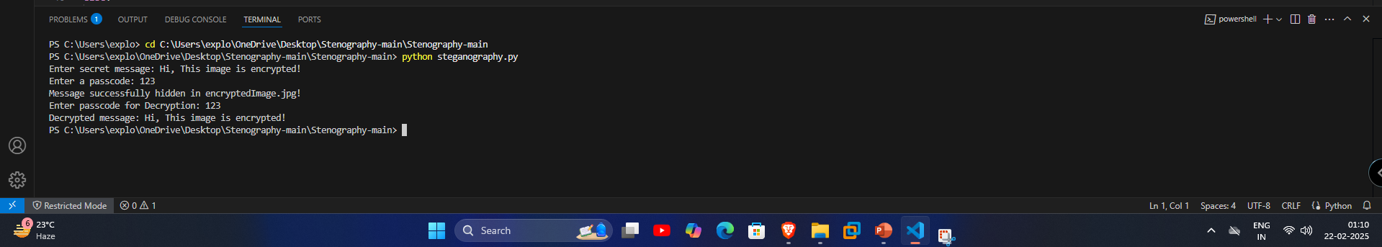
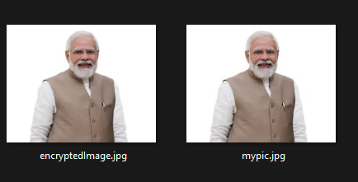

Slide 10
Conclusion
This project successfully demonstrates how steganography can be used to secure messages inside images. With additional security layers, this method can be an effective tool for confidential communication.

Slide 11
GitHub Link
https://github.com/tanishverse/edunet_project_skillsbuild

Slide 12
Future scope
Improve security by adding stronger encryption techniques.
Develop a GUI for easier usage.
Support multiple encryption layers.

Slide 13
THANK YOU

